Slide 1
Cyber security
By – IEEE MAIT
email :- saxenasiddharth571@gmail.com

Slide 2
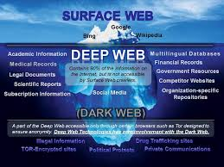
Different layers are
Surface Web
Deep Web
Dark Web

Slide 3
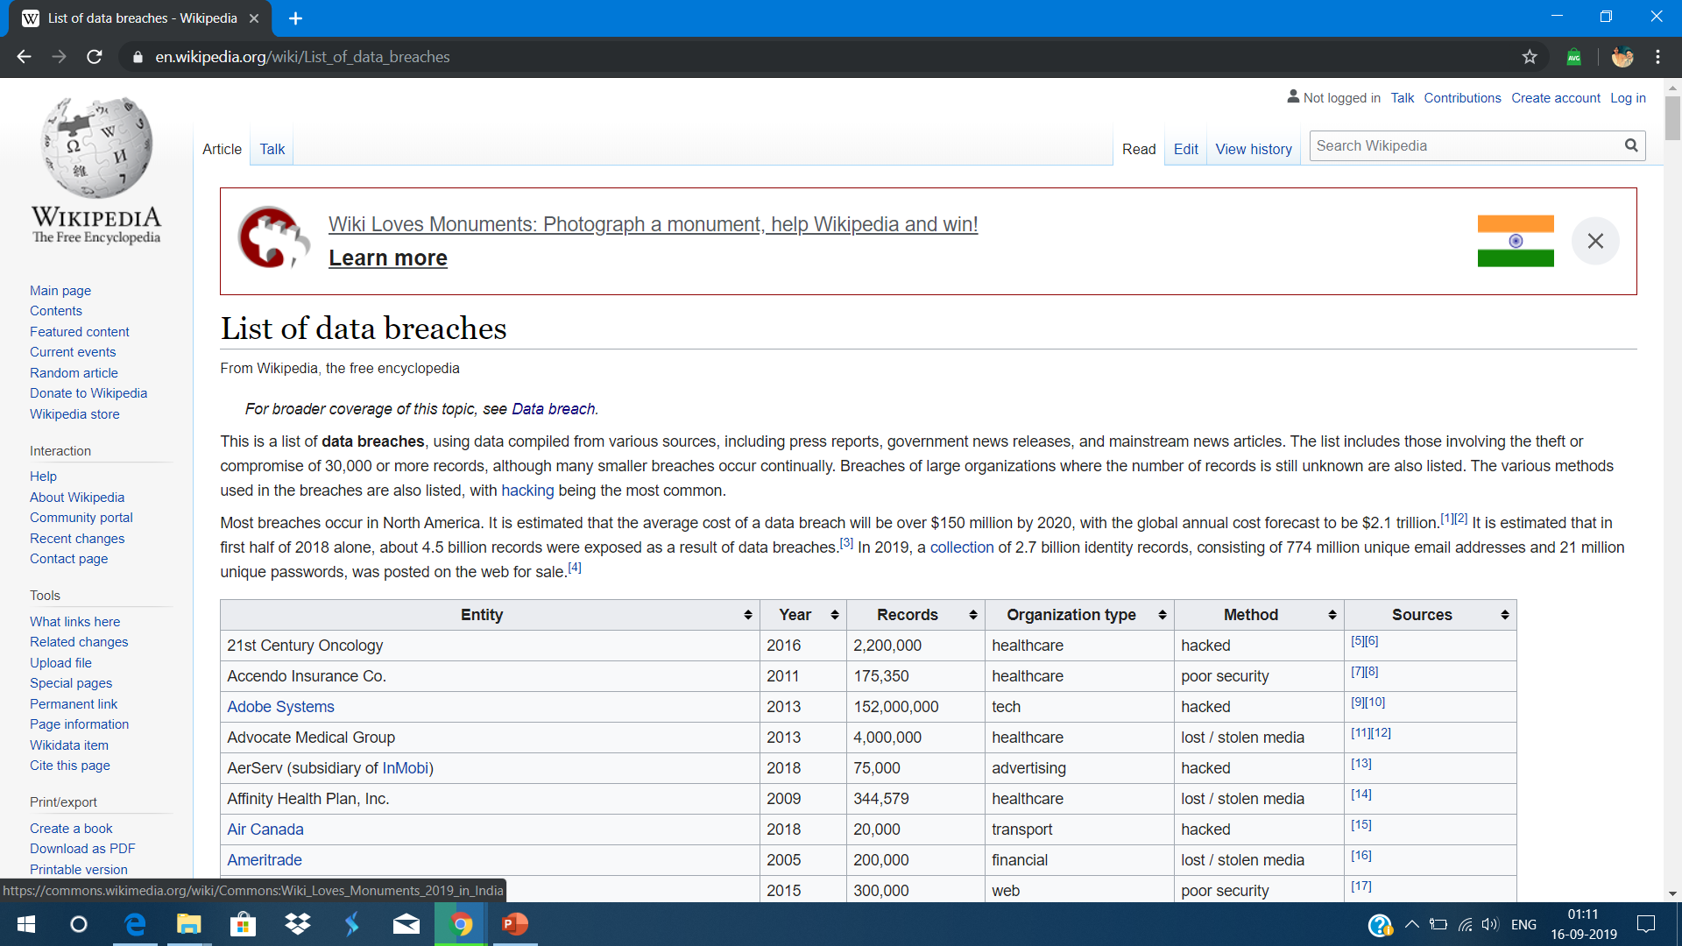
Information Security Overview

Slide 4
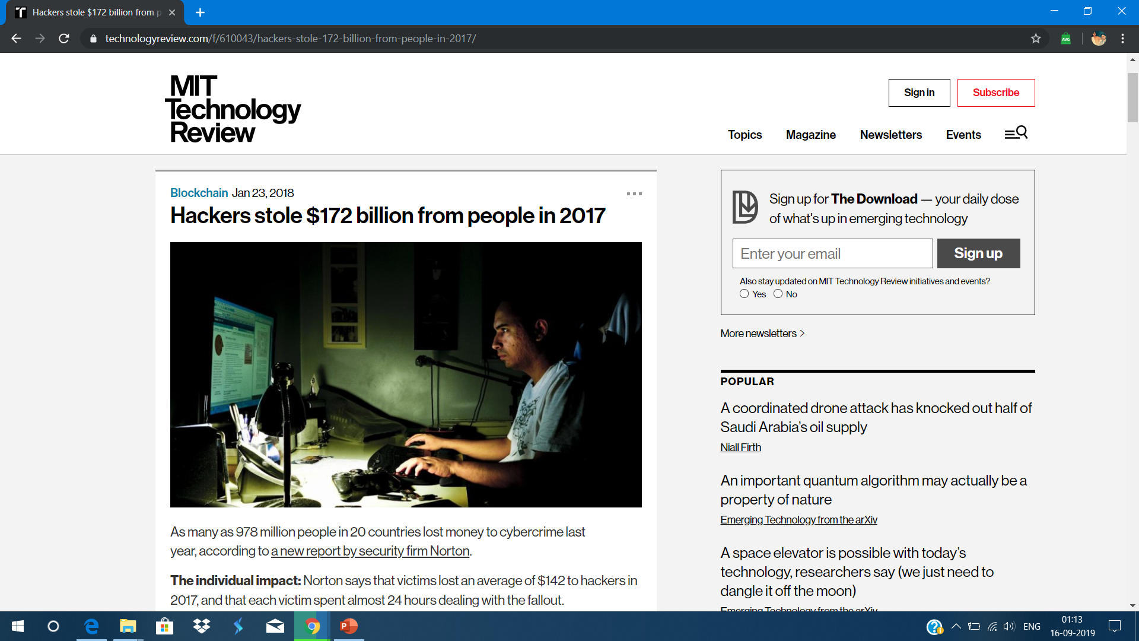
$172 billion dollars were stolen in 2017 by the hackers indulged in cyber crimes.

Slide 5
Information Security Threats and Attack vectors : -
ATTACK = MOTIVE + METHOD
VULNERABILITY MOTIVES BEHIND INFORMATIONSECURITY ATTACK:
Disrupting business continuity
Information theft
Manipulating data
Taking revenge

Slide 6
Hacking Concept:
What is a hacking ?
Exploiting system's vulnerability
Who is a Hacker ?
Individual with appropriate skills and ability to intrude into a system.
For some hackers, hacking is a hobby. They like to explore about how they can play and make there way with computers and networks.

Slide 7
Hacker classes
Black Hat: White Hat:
Individual with extraordinary Individual professing hacker skill
computing skills ,resorting to and using them for defensive
malicious or destructive activities purposes and also known as
they are known as cracker . security analyst.
Grey Hat:
Individuals who work both offensive
and defensive at various time.

Slide 8
Hacking phases: -
Reconnaissance
Scanning
Gaining Access
Maintaining Access
Clearing track

Slide 9
Ethical hacking concept and scope
Why Ethical Hacking is Necessary ?
“ TO BEAT A HACKER,YOU NEED TO THINK LIKE ONE “
Ethical hacker is necessary to counter attack against hackers .
Reason why organization recruit ethical hacker
To prevent hackers .
To analyze the strength of security posture.
To discover uncovered vulnerability .

Slide 10
<!DOCTYPE html>
<html>
<head>
<title>Question Time</title>
</head>
<body>
<b>WHAT IS DIFFERENCE BETWEEN HACKER AND CRACKER ?</b>
<b>WHAT ARE DIFFERENT PHASE OF HACKING ?</b>
<b>ARE WE SCRIPT Kidding (IGNORE ME LOL!) </b>
</body>
</html>

